Slide 1
Assessment Programs:
Deep Dive
September 17, 2018
Notes:
Use this slide for less text-heavy information.

Slide 2


Slide 3
Today’s Agenda
Time | Topic
9:00-10:45 | Welcome and roundtable
 | Assessment Programs Strategy Overview
 | Team and Personal Goals for this Meeting
10:45-11:00 AM | Break
11:00-12:00 PM | Portfolio Presentation
12:00-1:00 PM | Lunch
1:00-2:45 PM | Discussion – What do We Need to Deliver Our Must Wins?
2:45- 3:00 PM | Break
3:00- 5:00 PM | Proposed Action Plan and Wrap Up
 | Closing Remarks

Slide 4
Assessment Programs:
Strategy Overview
Notes:
Use this slide for less text-heavy information.

Slide 5
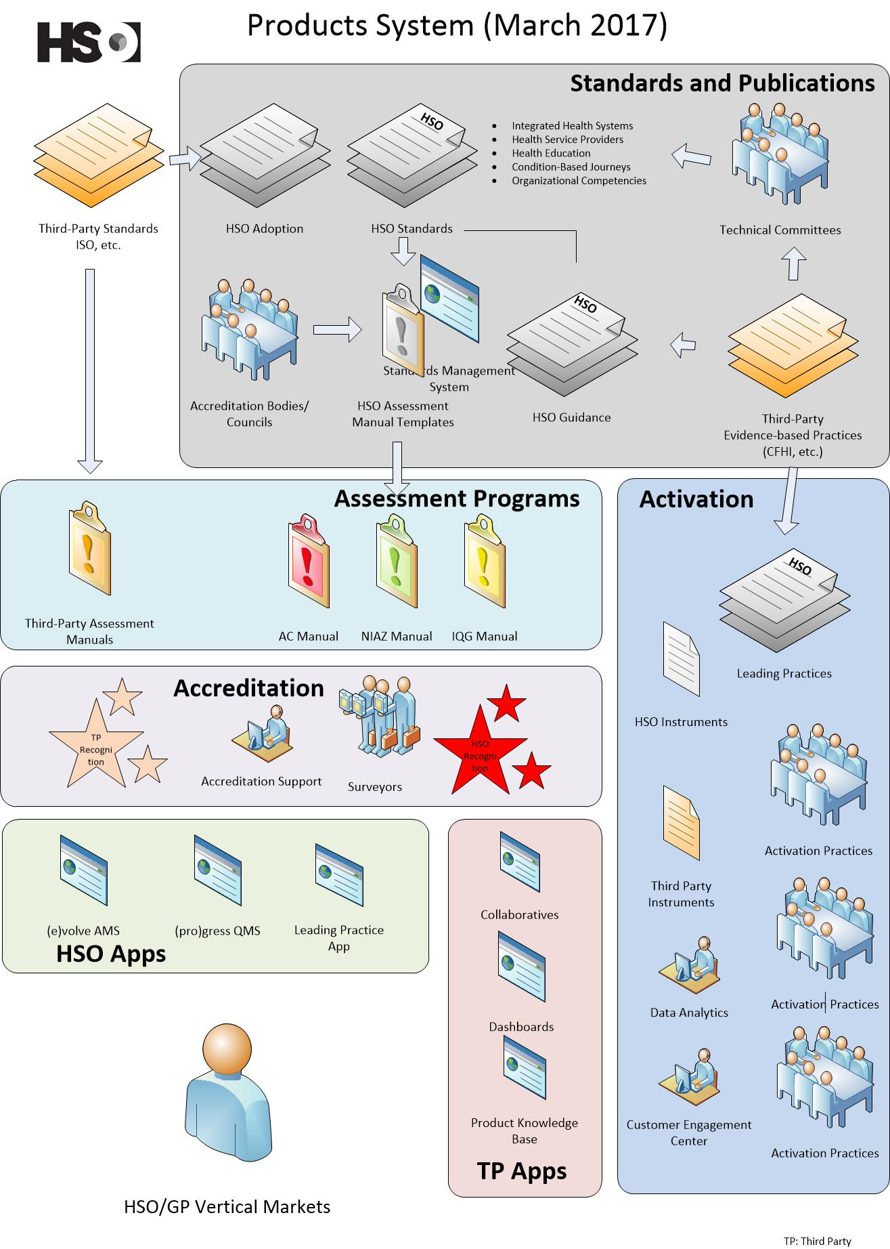
It is not the individual program, product or service that will position HSO favorably, but rather a careful assemblage of all of the above, to create a unique “product system” for which there is no comparable offering.
HSO Proprietary and Confidential

Slide 6

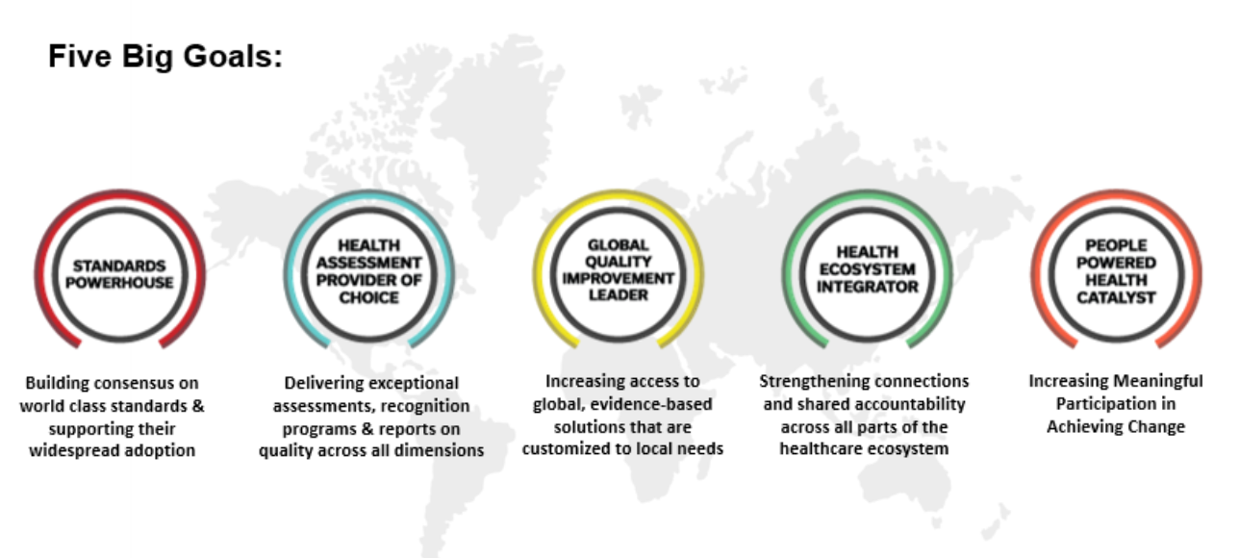

HSO’s Goals - Taglines
Standards powerhouse
Health assessment service provider of choice
Health ecosystem integrator
Global quality improvement leader
People powered health movement catalyst
HSO Proprietary and Confidential

Slide 8
Our Enterprise’s Goals (HSO)
Building consensus on standards that address identified needs, and supporting their widespread adoption
Assessing, recognizing and reporting on quality across all dimensions
Facilitating access to evidence based solutions customized to local needs
Strengthening connections and shared accountability across all parts of the heath ecosystem
Increasing meaningful participation in achieving change
HSO Proprietary and Confidential

Slide 9
Supporting our Enterprise’s Strategic Initiatives
The Global Programs Initiatives are:
Grow development and uptake of HSO standards
Launch and grow HSO Activation Services
Generate future product concepts
Grow uptake of assessment Programs through Global Program Partners
Enhance usability of standards and assessment programs through technology
Demonstrate leadership in Integrated Health Services
Design and test new survey models and assessment methods in field
Foster a positive, engaged workplace culture
HSO Proprietary and Confidential
Notes:
Linkage of personal objectives to strategic initiatives. Initiatives are linked to KPIs (slide 20)

Slide 10
Supporting our Enterprise’s Strategic Initiatives
The Global Programs Initiatives are:
Improve market and customer insights
Ensure program quality meets external accreditation body requirements of ISQua, SCC and CEN
Ensure long term financial health of HSO
HSO Proprietary and Confidential

Slide 11
CURRENT VALUE CREATION MODEL
Standards
Methodologies and Training
PE Customer Support
Need for scalable quality assurance or improvement model
Assessment Program Design
Assessment Services Delivery
Applications
Trademarks/
Goodwill
Activation Svcs,
Instruments and
Leading Practices
HSO Proprietary and Confidential

Slide 12
Innovative Assessment Programs and Methodologies.
Delivered Through Partnerships.
Notes:
This is a red section title slide. Use this slide between different topics.

Slide 13
Programs:
Innovative Assessments
Accreditation/
Commissioning
Recognition
Distinction
Peer Review
Certification

Slide 14

Qmentum Global Accreditation Program
Leveraging Health Service Provider Standards
Accredits Health Service Providers in partnership with 4 Global Program Partners and growing
Over 7000 sites accredited in 70 jurisdictions
3-4 year cycles, onsite reviews, attestation and audits
HSO Proprietary and Confidential

Slide 15
Distinction Programs
Leveraging Condition-Based Journey Standards
Two Programs:
Trauma Distinction
Stroke Distinction
Programs funded by Accreditation revenues at the moment
HSO Proprietary and Confidential

Slide 16





Program Licensees
Ministère de santé de Kowait
HSO Proprietary and Confidential

Slide 17
Licensed Programs
Programs licensed based on susbscription or franchise:
Trademarks
Standards
Software
Resources
Education Material
HSO Proprietary and Confidential

Slide 18
Licensed Programs
Program implementation supported through various services :
Project management
Committee management
Software configuration and customization
Training sessions
Co-surveys
Customer Support
Instrument deployment
Data analysis and program evaluation
HSO Proprietary and Confidential

Slide 19
HSO Assessment Programs 2018 Tactical Objectives
Launch Qmentum Global and support Global Program Partners
Launch EQual Canada
Expand partnership with CPSI and launch National Quality and Safety Advisory Committee – publishing new RQSPs
Innovate in developing more programs based on current standards and methods
Release of Certification program framework
Redesign Distinction approach and work with program sponsors
Intensify market development
Test new methodologies, adjust and publish
Build an Assessment Programs faculty
HSO Proprietary and Confidential

Slide 20
HSO KPIs
Link to operational definitions
1. Number of Standards published and in development
2. Number Normative references of HSO and AC in legislation / regulation
3. Number of customers participating in Activation Services
4. % Conformity with external accreditation: standards: ISQua, SCC, ESC
5. NPS of Accreditation Canada clients
6. Proportion of redesigned surveys / total external survey days
7. Number of Internal Audits clients performed on HSO platforms
8. Number of instrument respondents (on HSO platforms)
9. % Conformity with external accreditation: organization: ISQua, APLAC
10. Number of Global Program Partners
11. Number of Leading Practices viewers
12. Number of geographical jurisdictions with active contracts or licenses sold
13. Number of thought leadership engagements
14. Number of sites that have adopted HSO and AC products and services
15. Number of new Accreditation Canada client organizations in targeted verticals
16. EQual growth: proportion of actual to planned accreditation clients (allied health education programs) yearly target
17. Number of IHS-related projects (condition based, IHS)
18. NPS of TC/WG members and surveyors, including patients as subset
19. Q12 result - HSO staff
20. Number of PPH community members (TC and WG members, faculty, surveyors, client members, staff)
21. Web unique visitors (All websites)

Slide 21
Assessment Programs KPIs
Link to GP KPI file
Owner: Taissa
# of new assessments programs developed – Report
# of new assessments programs prototyped by CA, IA – Remove
# of existing "new" assessment programs uptake by new or existing clients (including EQUal) – Remove
Total Revenue - Assessment Programs – Report
# of new third-party program sponsors/program clients – Report
Maintenance of ISQua accreditation for GPP-selected standards/assessment manuals – Report
Proportion of days using new assessment methodologies days over all assessment days performed – Remove
Allied Health professions represented within Equal Canada program – Report
Assessment manuals, surveyor model for Quebec contract delivered – Report
Condition specific assessment programs are endorsed or sponsored – Report
# of Qmentum Global Licensees (including Affiliates) – Report
% of assessment manuals beta tested and published, on time – Report
# of Assessment Methodologies beta versions published – Report

Slide 22
How is Assessment Programs Success Measured?
In 2018:
10% - Increase in HSO-powered assessments
6 - Qmentum Global Licensees
25 - Assessment manuals beta tested and published
6 - Assessment methodologies beta tested and published
ISQua Accredited - Selected assessment manuals
$5.2M - Total revenue for Assessment Programs
Increase – Program Sponsors/clients
HSO Proprietary and Confidential

Slide 23
Team Structure
Director: Taissa Soto Mayor Team Support: Andrea Martinez
Section | Established Programs | Operations | Process | Innovation Programs | Project Implementation | Product Management
Team Member | PM: Vacant (Qendresa interim) Associate: Lamia Almorsy | PM: Qendresa Hasanaj Associates: Hana Qowrah; Andrea Castillo | PM: N/A Associate: Xuxu Han (additional support Hana Qowrah) | PM: Kasia Bruski Associate: Jennifer Lacroix | Associate: Alexandra Shirokova | Product Managers: Sierra Chouinard and Harry Verran
Activities | Qmetnum Global (QG) Program Council Equal Distinction GPP’s management QG Resources Accreditation Quebec | Assessment Methods Assessment Manuals Standards Quality Check for QG Assessment Tagging Team Operations | Process and SOP development Patient Quality and Safety Advisory Committee ISQua Accreditation | Recognition Certification Distinction Proposal Development (shared with Project Implementation i.e. Kuwait) Integrated Care Program | EQual Lebanon First Nations Kwuait Qatar | Accreditation Management Suite Legacy Systems Third Party Solutions Client Management Product Roadmap

Slide 24
Program Type | Accreditation (QG) | Distinction | Certification | Recognition | EQual
Description | A voluntary process that aims to improve the safety and quality of health services for the public | A voluntary process that aims to improve the safety and quality of health services for a condition specific model of care. | A voluntary process that aims to improve the safety and quality of health services for the public | A voluntary process that aims to improve the safety and quality of health services for the public | A voluntary education accreditation process that aims to ensure a standardized high level of quality of health science professions and education programs
Quality Improvement/ Assurance | Is a quality improvement process that measures continuous improvement with a focus on excellence | Is a quality improvement process that measures compliance against necessary standards for a specific condition | Is a quality assurance process that measures compliance against necessary standards | Is a quality improvement process that measures continuous improvement with a focus on a specific service | Is a quality improvement process that measures continuous improvement with a focus on excellence
Assessment Target | A holistic assessment of a health care organization across the continuum of care by an assessment body | A compliance assessment of a site, service or organization, against a specific standard and outcomes by an assessment body | A compliance assessment of a site, service or organization, against a specific standard by an assessment body | An assessment that highlights a specific service within a health care organization by the Sponsor or assessment body | A holistic assessment of a educational organization across the continuum of educational requirements by an assessment body
Levels | 3 achievable levels with varying thresholds | 2 achievable levels with varying threshold (Level 1: Collaborate; Level 2: Integrate) | 1 achievable levels (Compliant) | 5 achievable levels with varying thresholds | 3 achievable levels with varying thresholds
Award | Accreditation Status awarded to organization | Distinction status is awarded to organization | Certification of Assurance awarded to organization | Recognition Status awarded to organization | Accreditation Status awarded to organization

Slide 25
Operations Unit
Notes:
Use this slide for less text-heavy information.

Slide 26
Operations Unit
Mandate:
Ensuring Assessment Programs activities are coordinated to meet strategic and operational goals.
Ensuring there is cross-team learning and knowledge transfer within the unit and across HSO
Point-person for inquiries re: Assessment Programs internally and externally
Managing the Assessment Methodologies Activities

Slide 27
Assessment Methodologies
Notes:
Use this slide for less text-heavy information.

Slide 28

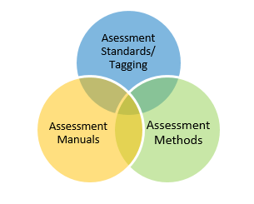

Slide 29
Assessment Methods
What:
In partnership with the Assessment methodologies Technical Committee, we build innovative assessment programs and methodologies which are used by clients (GPP’s and non GPP clients)
We have developed, reviewed, and revised 2 new assessment methodologies in 2017/2018
Attestation
Unannounced
We are currently working on a new assessment method.
Patient Journey
The Technical Committee will be coming to HSO Monday Oct 22, 2018 from 8-4pm for an in-person meeting to finalize the draft.

Slide 30
Assessment Methods
What it brings (the benefit/value):
Meets HSO strategic target of being a word class standards and assessment body
Ensures HSO assessment methods are up to date with the needs of GPP's and their clients
Is responsive to trends in accreditation and health services research
Is developed in partnership with patients and healthcare providers
HSO Proprietary and Confidential

Slide 31
Assessment Standards
What is it:
HSO Standards
Tagged to:
Assessment method
Priority process
Priority (high, low, ROP)
Quality Dimension
Once tagged, the HSO Standard becomes an Assessment standard and are owned by Assessment Programs.

Slide 32
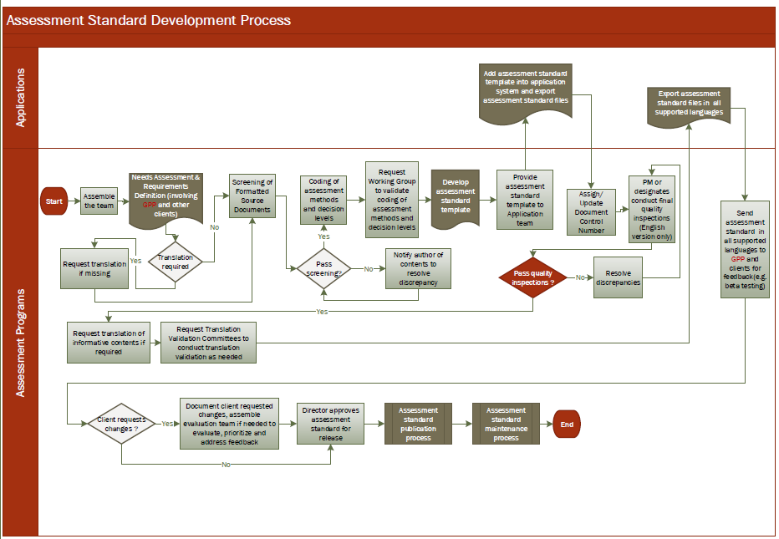

Slide 33
Assessment Manuals
What it is:
Assessment Manuals are used to assess an organizations performance against applicable assessment standards. It is essentially a package of standards used by clients, required for accreditation/certification/recognition.
What it is comprised of:
Combination of different standards
Tagging of all criteria and guidelines (assessment method, priority, quality dimension)
Types of Manuals
HSO Assessment Manuals | Are primarily composed of HSO Standards criteria. These may come from one or many standards, in part or in full. HSO develops templated manuals that can be used by Global Programs Partners for the assessment services.
Third Party Assessment Manuals | They use exclusively third-party intellectual property, however, generally using the HSO assessment manuals framework. Third-Party intellectual property may include legislative and regulatory requirements, third-party standards criteria, in part or in full and custom developed requirements, developed through Working Group consensus.
Composite Assessment Manuals | Composite manuals may include HSO and Third-Party content (eg. Qatar MOPH Inspection Protocols).
Notes:
Assessment Manuals will be developed for specific sectors (LTC, Homecare, Hospital, Hospital-Mental etc)
Assessment Manuals will be developed for recognition programs as necessary (i.e. SSF)

Slide 34
Assessment Manuals
What it brings (the benefit/value):
Make the assessment process easier to the GPPs and more transparent to the health service organizations.
Provide health services providers with a tool that contains all the information they need to know to participate in the accreditation program, including applicable standards’ criteria, assessment methods, and a rating scale.
Facilitate a more efficient and effective assessment by reducing the amount of duplication that appears across standards.
HSO Proprietary and Confidential
Notes:
Assessment Manuals will be developed for specific sectors (LTC, Homecare, Hospital, Hospital-Mental etc)
Assessment Manuals will be developed for recognition programs as necessary (i.e. SSF)

Slide 35
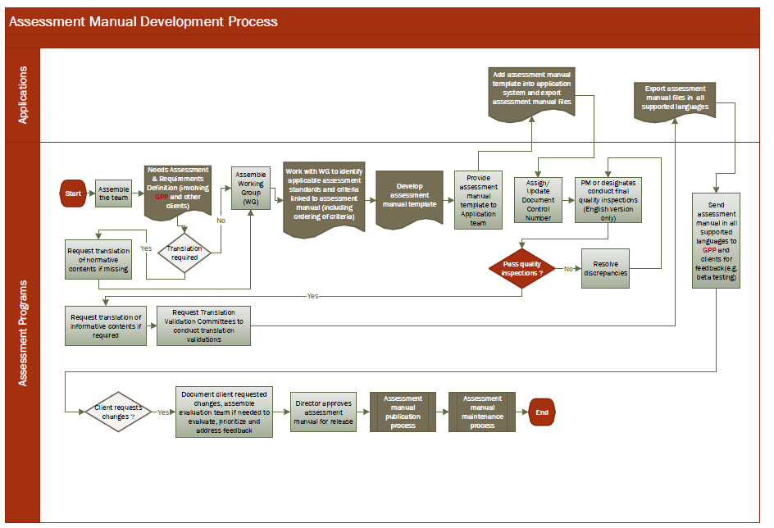

Slide 36
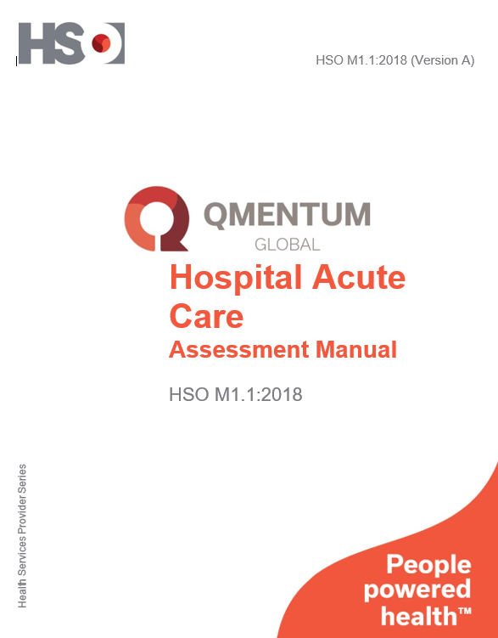
Assessment Manual Example

Slide 37
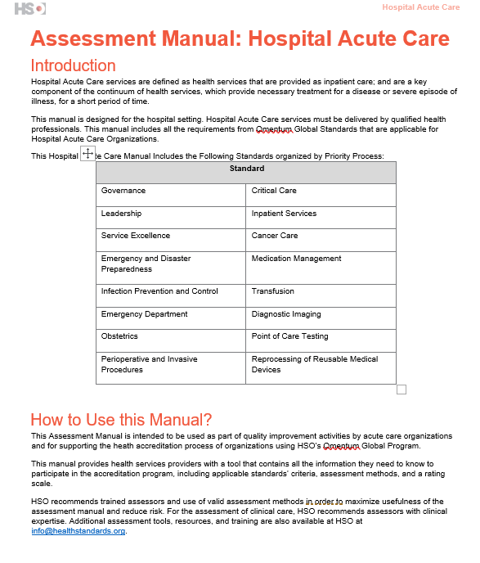
Notes:
This shows the different standards that are used to develop the Acute Care Manual

Slide 38
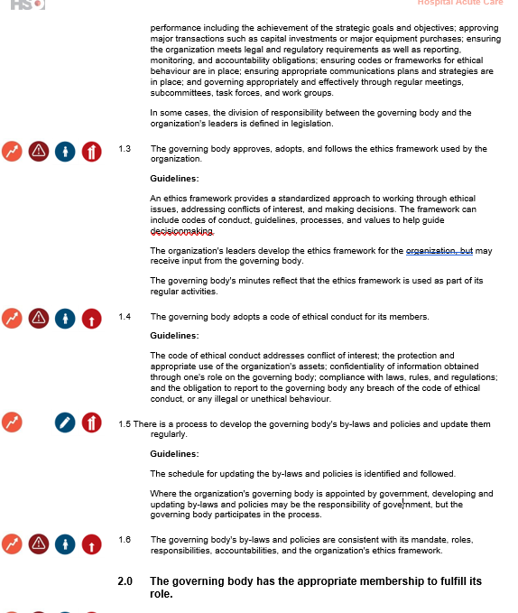
Assessment Tagging in Manual
Quality Dimension
Priority/ROP
Assessment Method
Level
Criteria
Notes:
Shows the tagging

Slide 39
Manual Classification
Full | No removal of criteria
Core | high priority ROP Level 1/Gold criteria
Available
LTC--- Full & Core
Primary Care--- Core
Acute Care--- Full
Quebec (Jeunesse)---- Customized

Slide 40
Established Programs

Slide 41

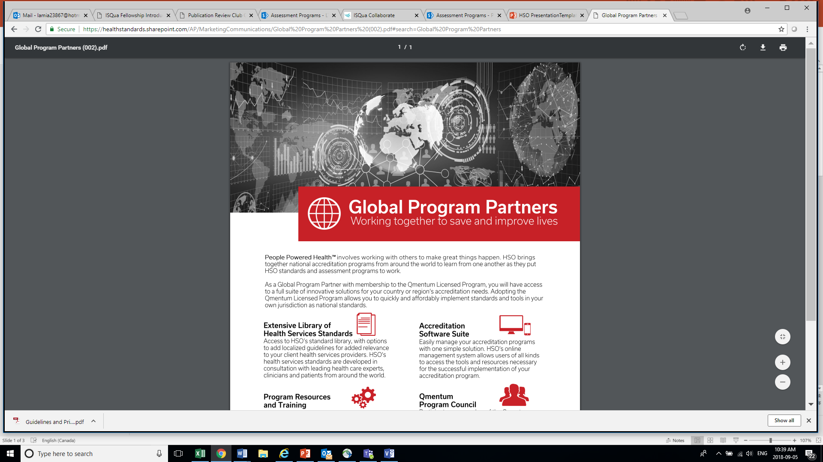

Established Programs
Notes:
Use this slide for less text-heavy information.

Slide 42
Qmentum Global
This program merged the Qmentum for Canada and Qmentum International into a single global accreditation program
Access to more standards
HSO standards have no major content added or deleted
Personalization through localized guidelines
New assessment methodologies & Assessment manuals
Additional software features
HSO Proprietary and Confidential

Slide 43
Accreditation
Process
Tool
Measure
A process for organizations to regularly and consistently examine and improve their services,
A tool to identify areas for improvement,
A measure used by an independent, third-party assessment of health care and social services organizations through standards built upon best practices,

Slide 44
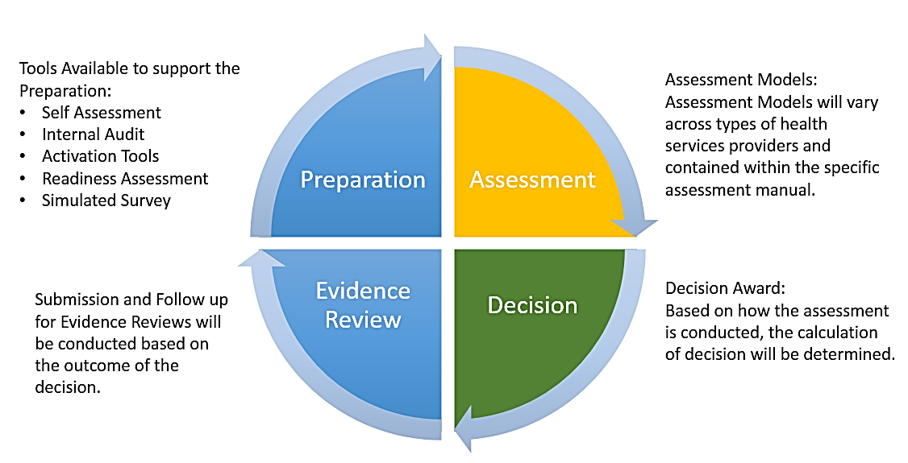
Qmentum Global Framework
Notes:
This is a two-column text slide. Use this slide for text-heavy sections of the presentation that have several points.
Using both the one- and two-column texts slides adds variety and interest to your presentation.

Slide 45

Qmentum Global
Standards
1
Resources
2
Instruments
3
Software
4
Notes:
This is a two-column text slide. Use this slide for text-heavy sections of the presentation that have several points.
Using both the one- and two-column texts slides adds variety and interest to your presentation.

Slide 46
Global Program Partners (GPPs)
GPPs are part of a network of governmental and non-governmental organizations that are implementing HSO Standards and Qmentum™ accreditation programs in their jurisdictions,
Becoming a GPP provides organizations and regulators with membership to the HSO’s licensed programs,
Through this membership, GPPs can access one of the largest libraries of health services standards as well as assessment methods and tools that are easily adaptable in any health ecosystem. In addition, HSO can work with them to assess their needs and provide customized support to help them implement a successful accreditation program within their jurisdictions,
GPPs also participate in co-designing the future of the Qmentum Global™ Accreditation program through their participation on the Qmentum Program Council,
As the implementers of the program, GPPs have a program governance role through the Qmentum Program Council – driving program development and having direct input in how the program is shaped to meet the needs of both health services providers and patients within their jurisdictions.

Slide 47



Global Program Partners (GPPs)
The Netherlands Institute for Accreditation in Health Care (NIAZ)
Brazil

Slide 48
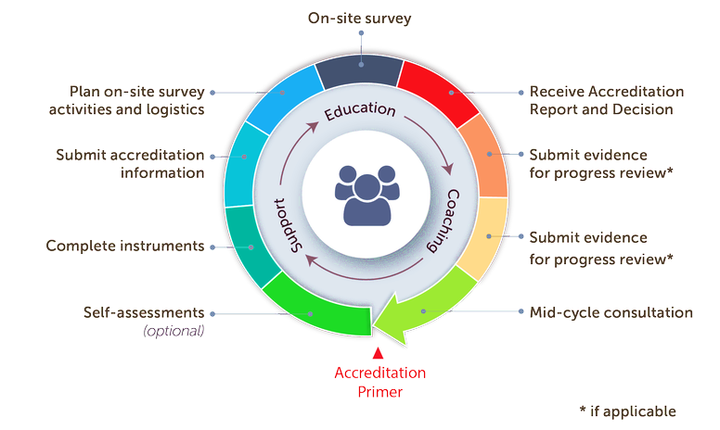
Accreditation Cycle
Notes:
The Accreditation Primer is the ﬁrst step in the accreditation journey for a new client. We work together to establish the supports, structures, and processes necessary for accreditation, with a particular focus on fundamental elements of quality and safety.

Slide 49
Distinction Program
Distinction is a rigorous and highly specialized accreditation program that assesses condition-specific models of care
Uses a condition specific standard (HSO, third-party or co-design)
Can also include HSO standards (e.g. Leadership)
Includes clinical performance indicators
Current Distinction Programs via AC:
Stroke
Trauma
Spinal Cord Injury
New Framework is currently in development
HSO Proprietary and Confidential

Slide 50
EQual Canada
Health Education Accreditation is a quality improvement process that supports health education programs, preparing graduates to deliver safe and effective care at entry to practice.
New Allied Health standard to be introduced in 2019 for implementation in 2020
New Method to be developed
Assessment Manual (development with WG)
Program Resources
EQual Canada is currently accreditation for 13 allied health professions
Growth strategy to be further refined.
HSO Proprietary and Confidential

Slide 51
Product Management Harry Verran Sierra Chouinard

Slide 52

HSO Platforms
What is a Platform?
A Platform is a group of Technologies that is used as the base for which other applications are developed.
These Applications support the Assessment Programs, GPPs, their clients and standalone clients.

Slide 53
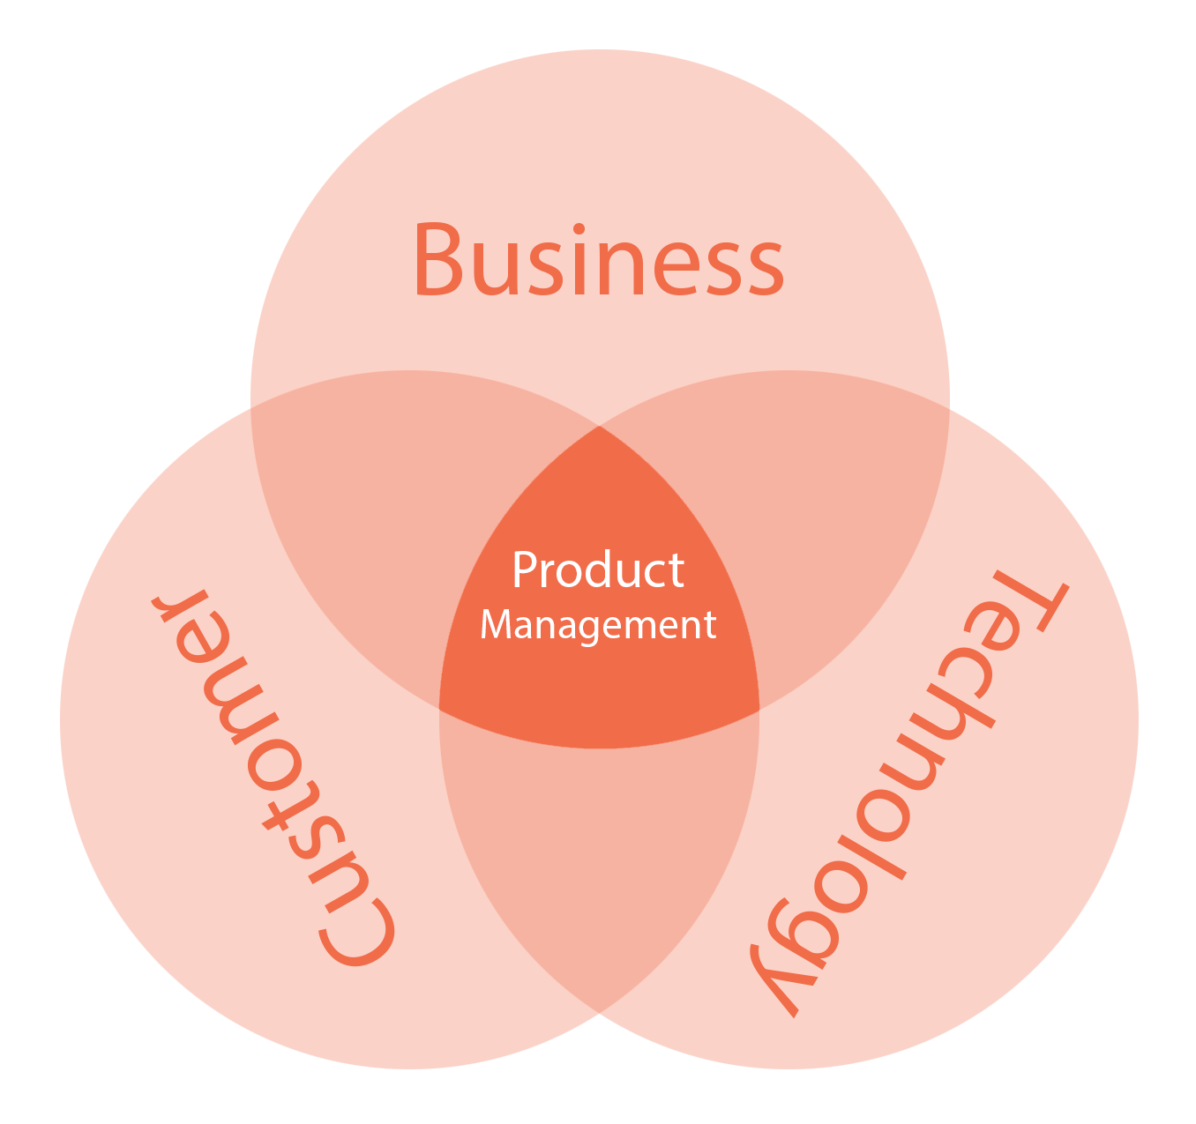
Product Management Activities
Linking the Assessment Program to the Customer and Appropriate Platform
Finance & Platform Pricing
Legal & Contracts
Software Recommendation
Proposal Involvement
Support Program Implementation
Methodology Pilots
Client Management
Product Roadmap
Cross Functional Team Support
Product Backlog

Slide 54

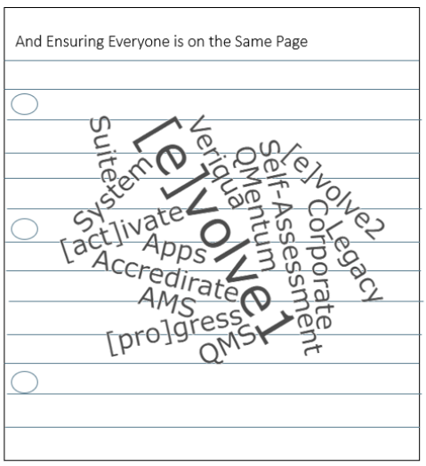
Getting to know the Legacy Platforms….
Provide Clarity (Naming and Tools)
Develop a Pricing Strategy
Identify Platform-Fit according to Program Requirements

Slide 55

HSO Platforms
Portal Administration
GPP Client Profile
Demographics (Self Assessment & Instrument Analysis)
Past Survey Results
Quality Performance Roadmap
Document Center (pre-survey)
Prepare for Survey
Portal Administration
GPP Client Profile
Demographics (Self Assessment & Instrument Analysis)
Self Assessment
Instruments
Audit
Survey Results
Quality Performance
Resources
Locations
Financials
Scheduling
Surveyor Assignments
Survey Admin
Client Admin
Report Editing
Surveyor Software
On-Site Surveys
Readiness Assessments (IA)
Profile
Indicators
Self Assessment
Protocols
Excellence
Standards
Results
Resources
Primary Profile
Primary Address
Standards
CA Lead
Sector
Owner (Health System)
Contacts (feeds in portal)
Past Surveys
Survey Team
Organization Services
Surveyor Comments
Decision
Appeals
Follow-Ups
Focus Visits
Minutes
Evidence review portal
Feeds into ADC and Client Portal
Clients submit through portal

Slide 56
Assessment Body / Program vs Application
Assessment Body / Program | QMentum | [e]volve 1.0 | Assessment and Quality Management Suite
Canadian Accreditation
International Accreditation
NIAZ
IQG
EQual
Quebec Certification
Quebec Accreditation
Lebanon
Not used
In-use but involved in transition phase to/from different application
Currently being used (status quo)
Contract Signed. Platform TBC.

Slide 57
Implementation

Slide 58
Project Implementation Unit
Purpose: to ensure effective implementation of signed contracts on health care quality assessment programs.
Current Projects
EQual Canada
MOPH Lebanon (Phase 6)
Pipeline
MOH Kuwait
MOPH Lebanon (Phase 7)
FNHA
MOH Qatar
Notes:
Use this slide for less text-heavy information.

Slide 59
EQual Canada: Health Education Accreditation
Objective: to standardize the quality of educational programs across 13 allied health professions.
When: surveys on a new STD and software due in 2020.
Program Components | Date (due) | Status
1) Allied Health Education Standard | Aug 2019 | Delayed/In progress
2) Software | TBD | Delayed/In progress
3) Program Resources | Nov 2019 | Not started
4) ADC Setup | Apr 2018 | Complete
5) Surveyor Management | Throughout | In progress
6) Program Governance Structure Setup | Jan 2018 | Complete
6) Leading Practices Database | Late 2019 | In progress
Notes:
This is a one-column text slide. Use this slide for text-heavy sections of the presentation.
Using both the one- and two-column texts slides adds variety and interest to your presentation.

Slide 60
PHC Accreditation - MOH Lebanon - Phase 6
Cooperation since 2009 to design and enhance the National Primary Health Care Accreditation Program.
Outcome of 6 project phases:
108 PHCs completed readiness assessment
58 actual surveys
223 surveyors participated in the surveyor training
Phase 6 Deliverables | Status
General Workshops for PHC Reps (3) | Complete
Surveyor Trainings (2) | Complete
Software Setup | Complete
Accreditation Co-surveys (20) | Complete
Notes:
This is a two-column text slide. Use this slide for text-heavy sections of the presentation that have several points.
Using both the one- and two-column texts slides adds variety and interest to your presentation.

Slide 61
First Nations Health Authority (FNHA)
Objective: Improve the delivery of health care in First Nations communities through the introduction of a Cultural Safety and Humility Standard and a recognition program.
Project Director – Madeleine Drew. Seconded until July 2020.
Contract | Description | Status
Contract #1 | Secondment of Project Director | Complete
Contract #2 | STD Development | In progress
Contract #3 | Recognition Program Development | Not started
Notes:
This is a one-column text slide. Use this slide for text-heavy sections of the presentation.
Using both the one- and two-column texts slides adds variety and interest to your presentation.

Slide 62
A few proposals in negotiation…
CLIENT | CONTRACT DELIVERABLES
MOPH Lebanon (Phase 7) | General Workshops for PHC Representatives (4) Surveyor Trainings (2) Self-Assessments (40) Accreditation Co-surveys (40)
MOH Kuwait (Qmentum Global) | Become a GPP and license Qmentum Global Program
MOH Qatar | HSO Accreditation Software Licence Licensing Software Updates and Testing Training on Licensing Software Technical Support
Notes:
This is a one-column text slide. Use this slide for text-heavy sections of the presentation.
Using both the one- and two-column texts slides adds variety and interest to your presentation.

Slide 63
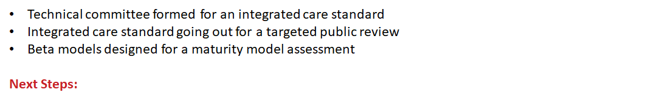
Innovation

Slide 64
What does the innovation team do?
Service Expansion
Market Expansion
Existing Services/Products
New Services/Products
Increase our market share of established services in existing geographies
Add new services in existing geographies
Existing Markets
The GP Assessment Innovation Portfolio is responsible for designing and deploying service expansions (new assessment services) for new and existing clients
Enter new geographies with established services
Add new services in new geographies
New Markets
Notes:
This is a two-column text slide. Use this slide for text-heavy sections of the presentation that have several points.
Using both the one- and two-column texts slides adds variety and interest to your presentation.

Slide 65
Recognition Program
What:
An HSO Recognition Program is a quality improvement process that measures continuous improvement based on a small set of standards requirements or an organizational competency.
Successful organizations are granted a Recognition Status from a 5-point maturity scale.
When:
The first Recognition Program is being launched April 1, 2019.
Notes:
Shows the tagging. Core Porgram

Slide 66
Recognition Programs in development
See SharePoint link:
https://healthstandards.sharepoint.com/:x:/r/AP/Third%20Party%20Programs/4.0%20Product_Service%20Development/4.2%20Recognition%20Offering/Recognition%20Program%20Development.xlsx?d=wd7b240329cc44fe488ff1350584b0c06&csf=1&e=jJoX6e

Slide 67
Certification Program
What:
The HSO Certification Program is a quality assurance process that measures compliance against necessary standards.
Certification demonstrates the ability of health organizations to meet HSO quality and safety requirements for the needs of citizens, patients and families, resulting in enhanced confidence and experience.
When:
QC Certification is LIVE
HSO Certification is currently in development
Notes:
Shows the tagging

Slide 68
Certification Programs in development
See SharePoint link:
https://healthstandards.sharepoint.com/:x:/r/AP/Third%20Party%20Programs/4.0%20Product_Service%20Development/4.1%20Certification%20Offering/Certification%20Program%20Development.xlsx?d=w2ba318188e374f7590ae4de4c893bb5d&csf=1&e=avTB4q

Slide 69
Québec Accreditation
What:
The Québec Accreditation Program is a variation on the Qmentum Global Program; however similar concepts apply.
When:
The QC Accreditation Program is being launched October 1, 2018.
Notes:
Shows the tagging

Slide 70
Integrated Care Program
Notes:
Shows the tagging

Slide 71
Setting the stage…
Aging population
Negative lifestyle factors increase (smoking, alcohol, obesity etc.)
Increased prevalence of complex patients with multiple conditions
Changing patient and public expectations
New advances in technologies
Increased occurrences of emergency admissions of patients that could be better treated in other, more cost effective settings
Rising costs
There are common challenges facing health systems around the world
These challenges are negatively impacting the quality of health services and sustainability of health systems worldwide

Slide 72
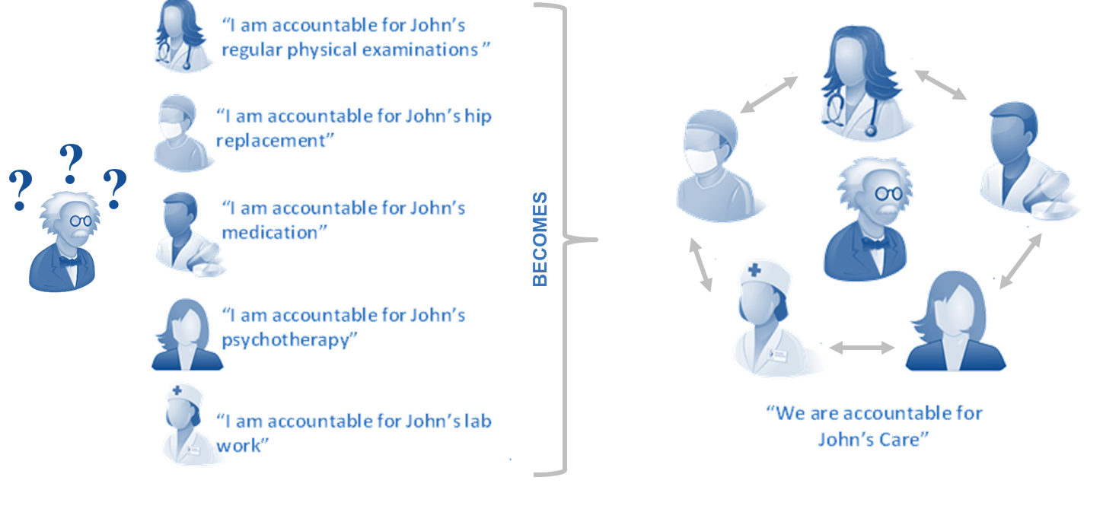
Many jurisdictions are looking to deploy new models of integrated care as solutions to these challenges
What do we mean by integration?
Help jurisdictions clarify what best practices integration looks like, where they are on that journey, and how to get there.
Notes:
This is a two-column text slide. Use this slide for text-heavy sections of the presentation that have several points.
Using both the one- and two-column texts slides adds variety and interest to your presentation.

Slide 73
This is a lot easier said than done…
In most cases, achieving effective integrated health and care services is a disruptive transformation for the health economy overall - which cannot happen overnight.
It is a dynamic and evolving journey that requires a shift in care model, business model, and health and care system culture overall
In fact, many jurisdictions are unclear what effective integrated care looks like and the best local approach to tackle it
Help jurisdictions clarify what best practices integration looks like, where they are on that journey, and how to get there.
Notes:
This is a two-column text slide. Use this slide for text-heavy sections of the presentation that have several points.
Using both the one- and two-column texts slides adds variety and interest to your presentation.

Slide 74
We are developing an HSO Integrated Care Program ICP
It will target health jurisdiction implementing whole systems integrated care approaches
The goal of the program will be to help jurisdictions clarify what good integration looks like, where they are on their journey, and how to get there
What has been completed to date:
Technical committee formed for an integrated care standard
Integrated care standard going out for a targeted public review
Beta models designed for a maturity model assessment
Next Steps:
Design a comprehensive strategy and program framework
Identify and deploy pilot opportunities
Notes:
This is a two-column text slide. Use this slide for text-heavy sections of the presentation that have several points.
Using both the one- and two-column texts slides adds variety and interest to your presentation.

Slide 75
Process and Safety

